Slide 1
Input & Variables
Getting inputs and manipulating variables

Slide 2
Libraries
So far we have used the System.out.println() to print out most of our statement
The System here refers to the library that Java fetches when we want to print something out
All libraries are an extensive collection of classes that can help your program

Slide 3
Inputs
So far, we have use Java’s System.out, a library, to handle our print statements
While there is a System.in, it is far too complicated for our need

Slide 4
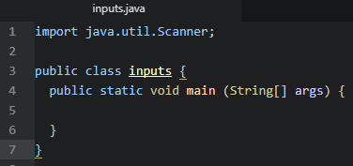
Scanner
Scanner, or java.util.Scanner, is the library that we will use to help us take input from the user
To start, we need to import Scanner with the import command

Slide 5
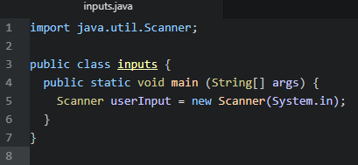
Creating a scanner
We are now going to create an instance of the Scanner class in our ‘inputs’ class

Slide 6
Inputs with variables
Now that we can take user inputs, lets combine that with variables to print out something interesting

Slide 7
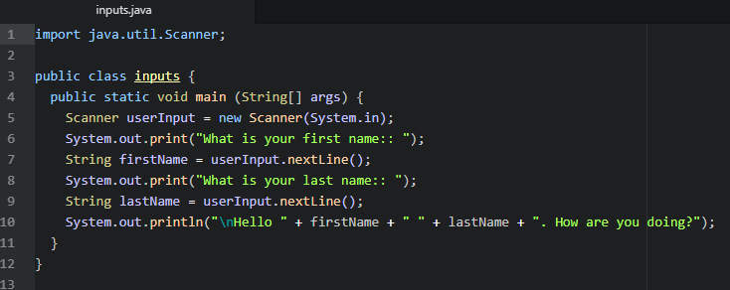
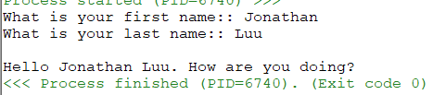
Taking user input
When we take user input, we must use the name we gave to our scanner

Slide 8
Different user inputs
So far we have been mainly using String, but Scanner can also take numbers in
We just need to change the method that we attach to the Scanner

Slide 9
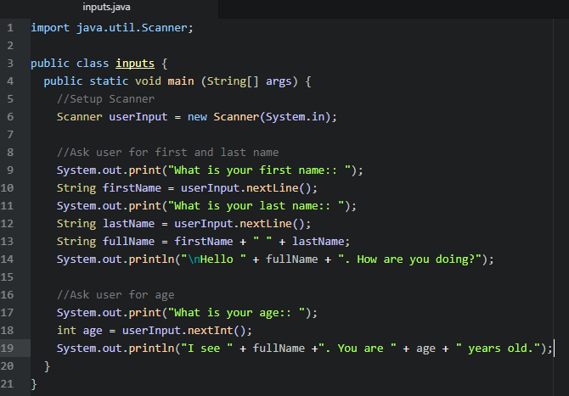
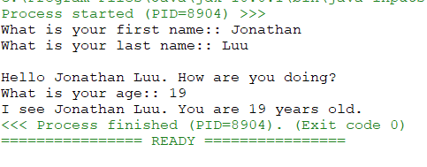
Different user inputs

